Slide 1
NLP for Robotics
Nick Georgiou
10/29/2020

Slide 2
Overview
Robotics Background with Potential NLP applications
Discussion of Papers
Discussion Questions

Slide 3
Background

Slide 4
Importance of NLP in Robotics
Robots are real-world, embodied agents
Our environments are very human-centric
Need robots to understand and be able to interact within our world
Want robots to interact with humans in a realistic, “natural” way
Knowledge and Commonsense, Language Grounding, Semantic Parsing, Survey Generation, etc.
All have a place in Robotics!
Why is this important?
Human robot collaboration (trust, acceptance, etc)

Slide 5
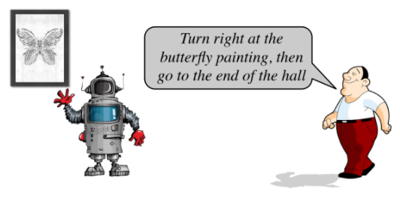
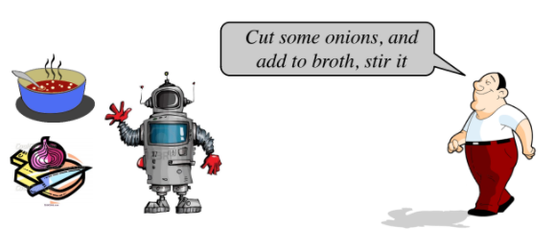
Importance of NLP in Robotics
https://www.cs.unc.edu/~mbansal/teaching/slidesSpr17/nlp_comp790_spring2017_lec1_jan17.pdf

Slide 6
Multi-Modality
Robots have the advantage of multimodal perception (cameras - vision, microphones - hearing, haptic - touch, etc.)
Robots have motors that allow them to move around and more greatly explore their environments (“that object in the back-left corner”, “behind the chair”,
Significant advantage to have access to more data about the environment
Compare with only having text
Especially important with local problems/conversation
Language grounding
Learn meaning of language with respect to the physical world
Combine perception and NLP to “ground” physical objects in the world to language
Navigation, Manipulation

Slide 7
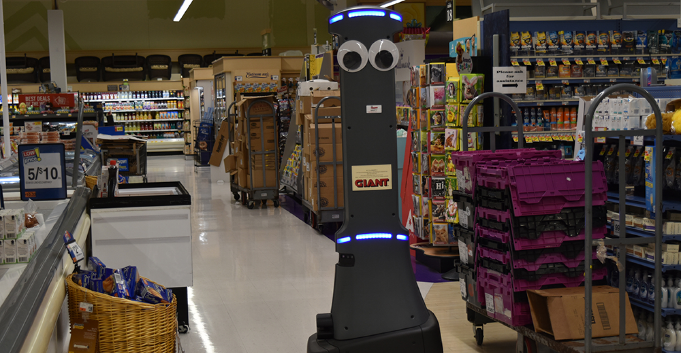
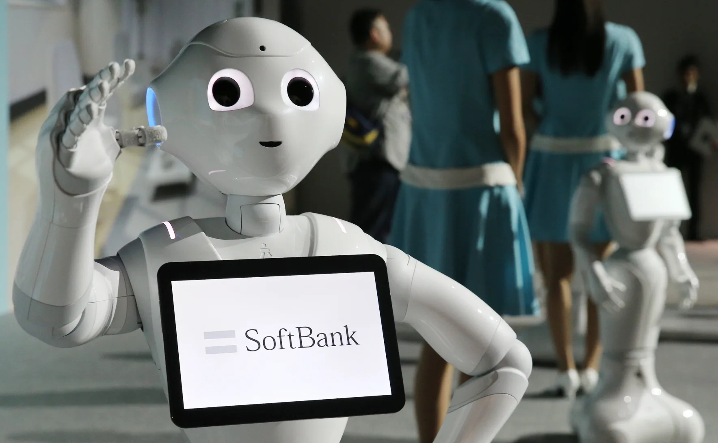
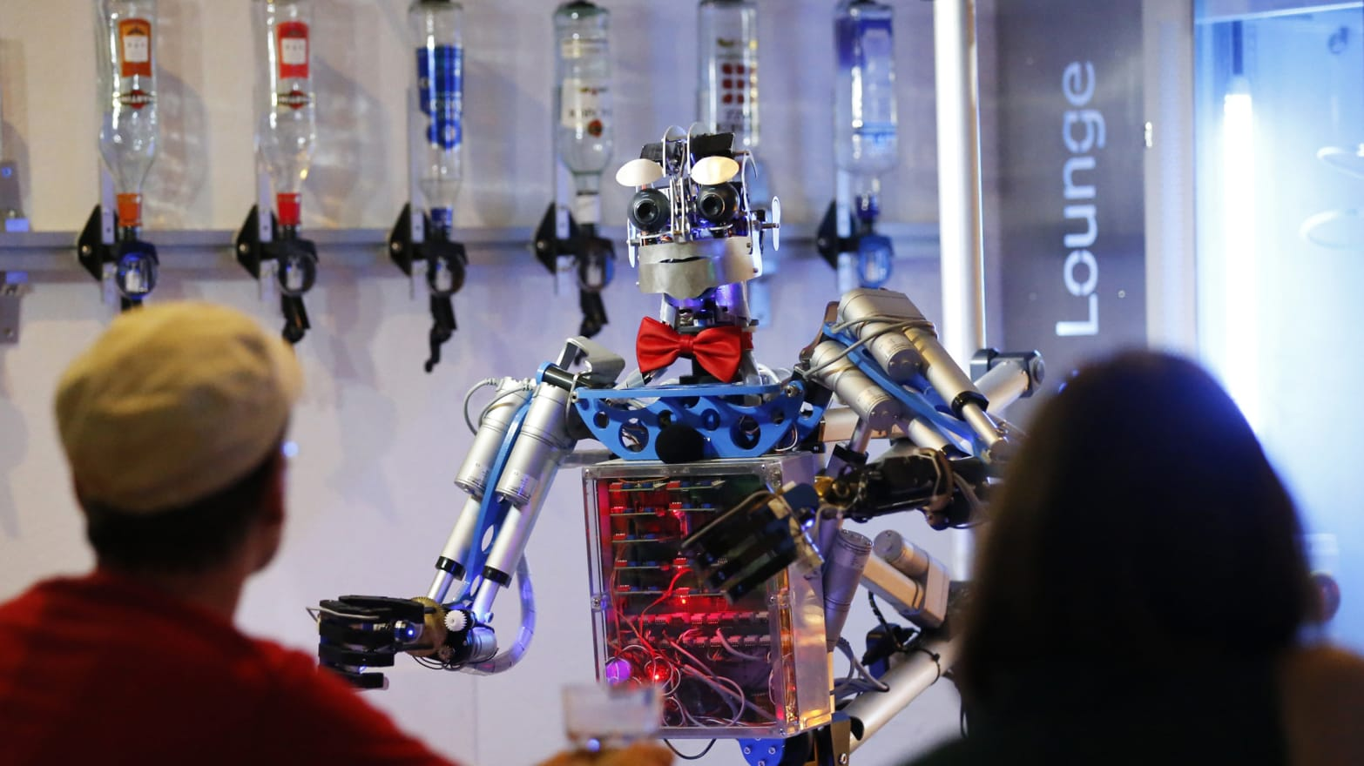
Everyday Robots & HRI
Robots becoming more present in our everyday lives
Important that non-experts can naturally interact and communicate with them

Slide 8
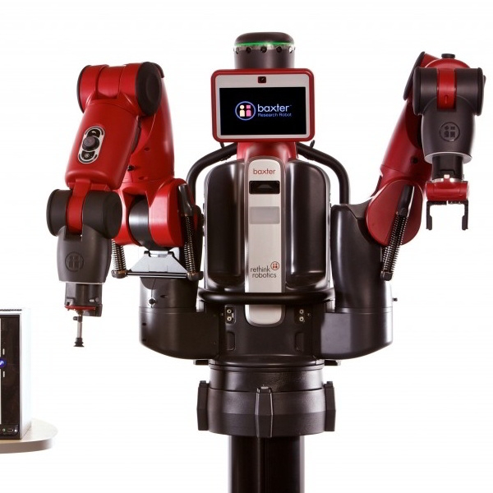
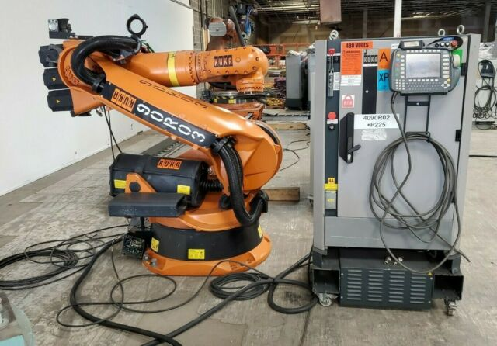
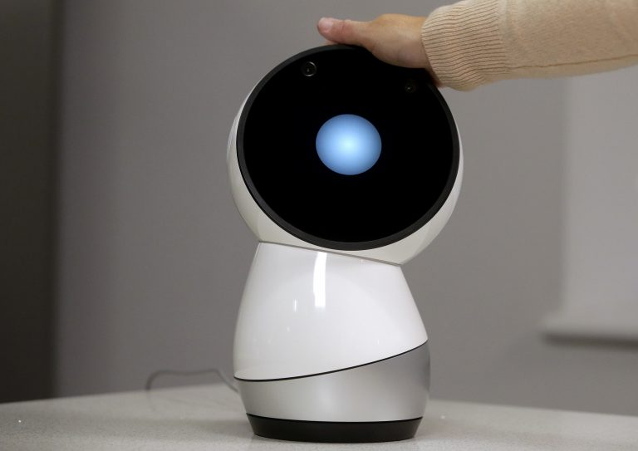

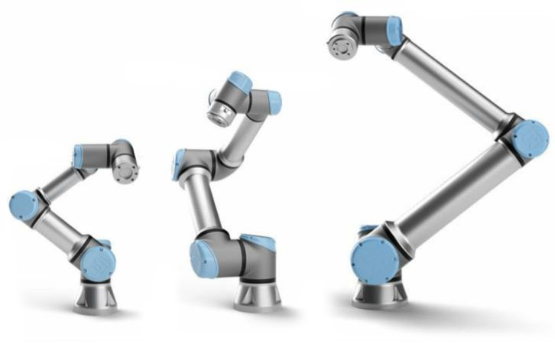
More Robots!

Slide 9
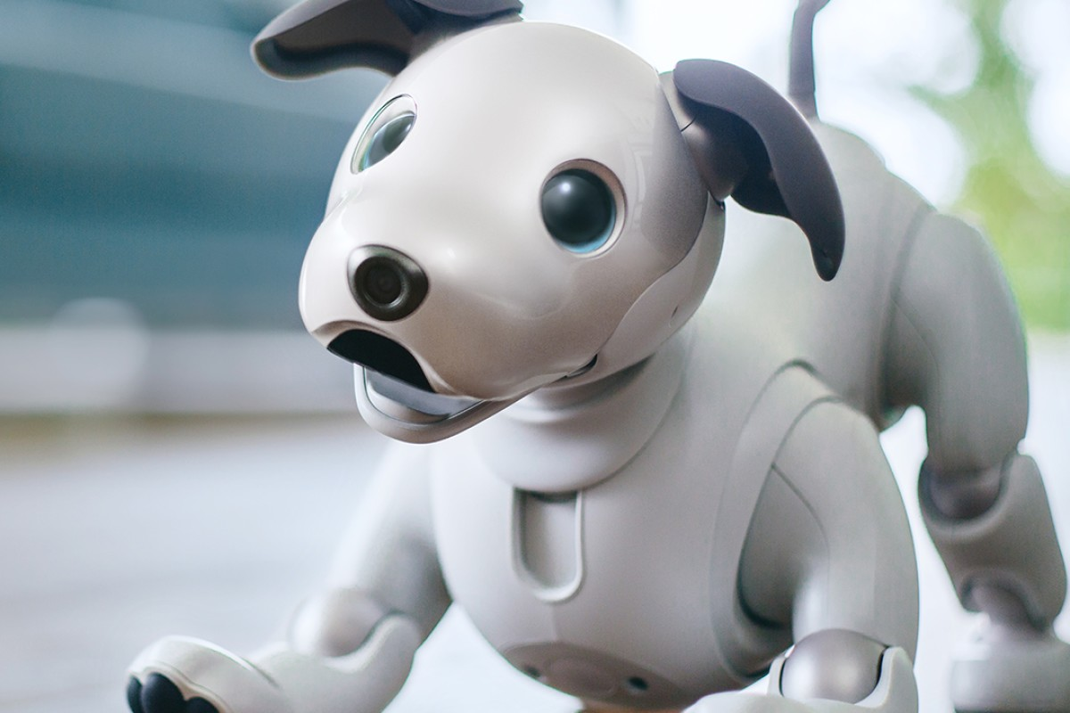
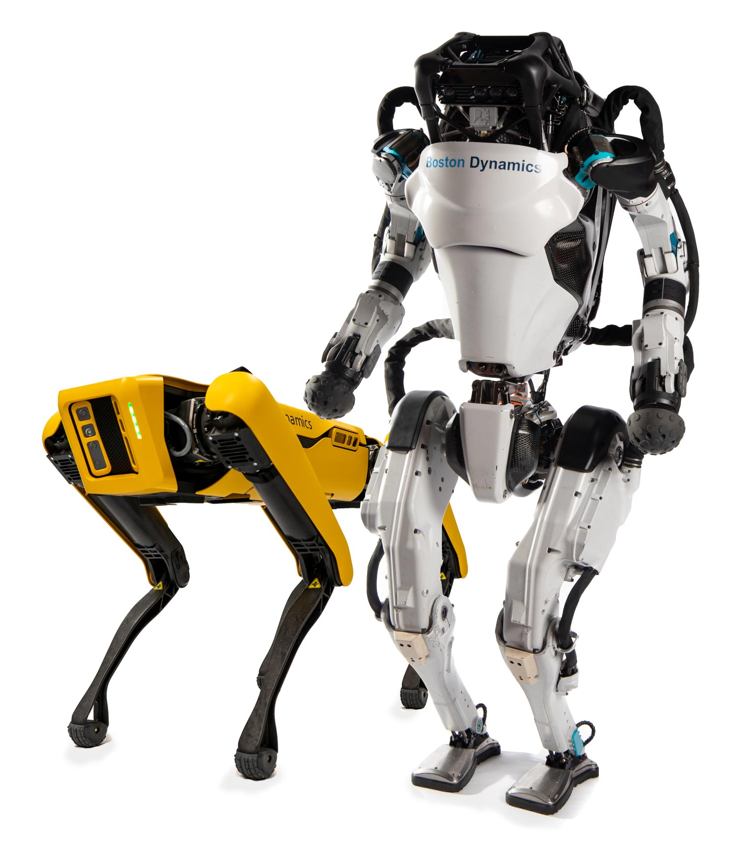
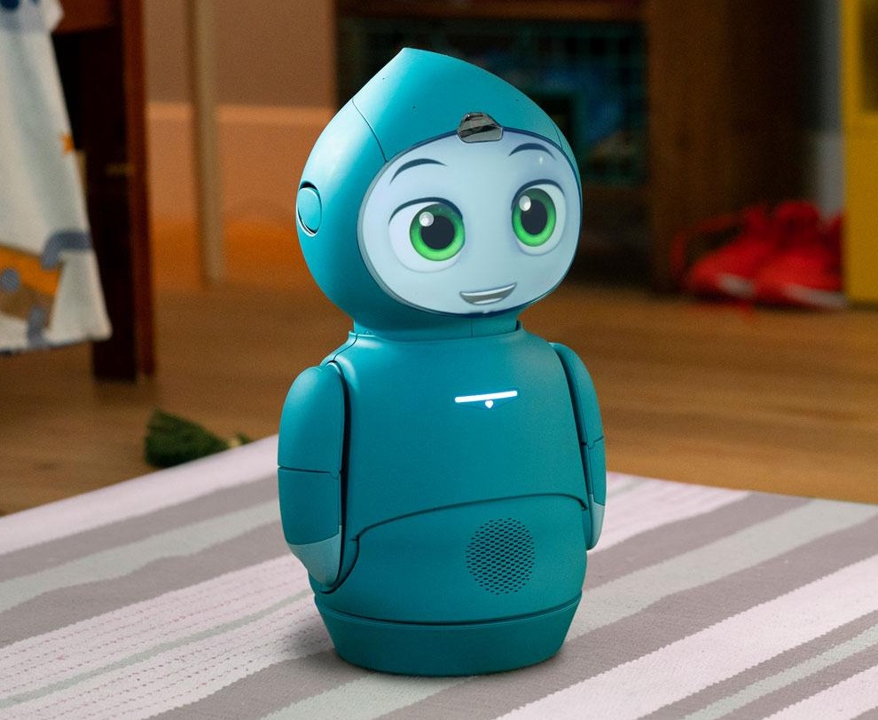
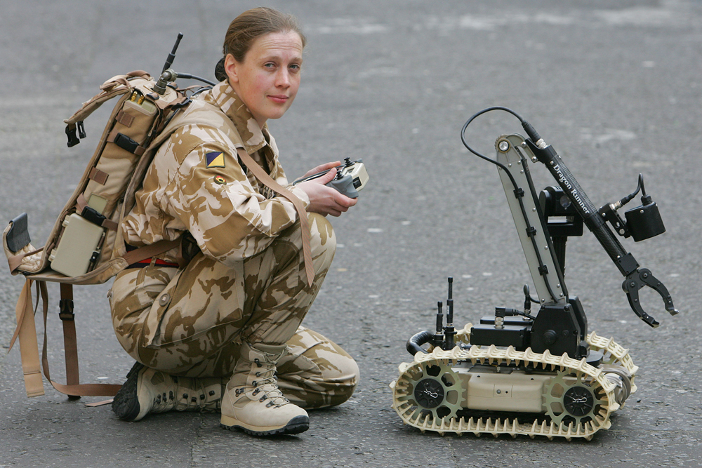
And More Robots!

Slide 10
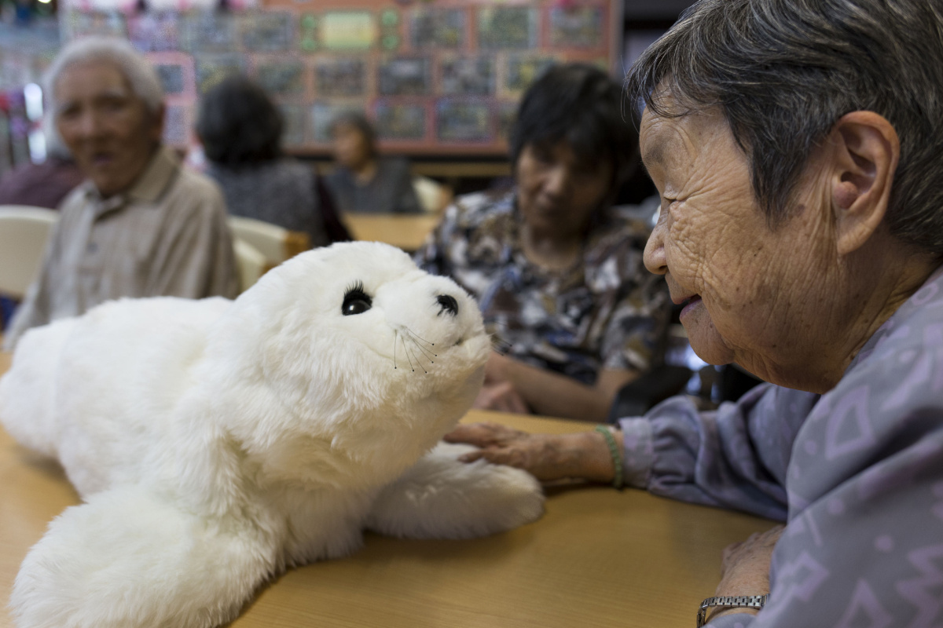
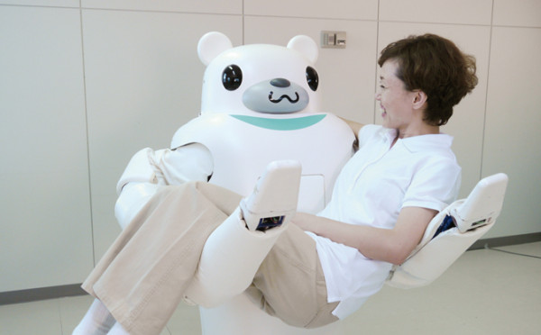
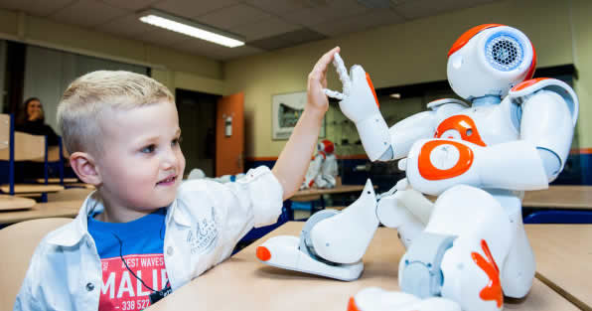
Socially Assistive Robotics
Robots that help humans through social interaction
Elderly
Help encourage discussion with peers, decrease depression rates (Paro)
Help with fetching items and moving the elderly (Robear)
Rehabilitation
Help people recover after a stroke
Individuals with Autism Spectrum Disorder
Robots fit a niche social category - more engagement than computer screen, less social pressure than a human
Can help with teaching social skills
Notes:
Also language grounding/RL which borui and nathan gave us a taste of. Wanted to keep this presentation to talk about more human involved robotics with NLP

Slide 11
Interpreting and Executing Recipes with a Cooking Robot
Authors: Mario Bollini et al.
Experimental Robotics 2013

Slide 12
Overview
Cooking is an important, commonplace household activity
Kitchen is a semi-structured environment, so makes it more possible for a robot chef to find success
Normal perceptual obstacles
Being able to find ingredients in cluttered environments
Manipulating various human-centric objects and performing hard tasks like mixing
Some environmental benefits
Kitchens have some organization
There are a finite amount of commonplace kitchen objects and items
Recipes tend to be organized and pretty sequential, as well as relatively simple
Robot (BakeBot) should collect recipes online, parse them into a sequence of actions, and execute them

Slide 13
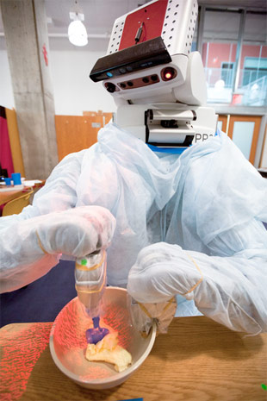
Problem
Robot has access to a set of all ingredients and their labels, locations of tools, and actions like pouring ingredients into a bowl and mixing
Must parse recipe text and infer action sequence that it then performs
“Add sugar and beat to a cream”
Empty bowl of sugar into a mixing bowl
Stir ingredients

Slide 14
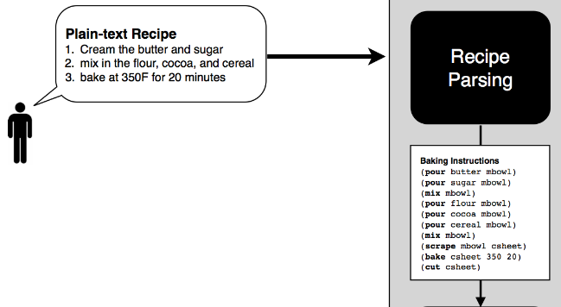

Slide 15
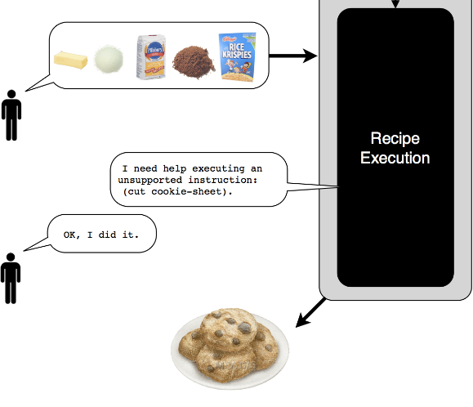

Slide 16
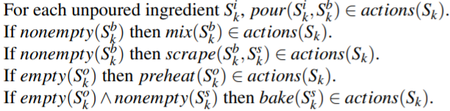
Recipe Handling (State/Action Space)
Handle plain-text recipe sentence by sentence, represent in state/action space
Actions such as pour, mix, scrape, preheat, bake
If the robot does not have an action supported that is needed in the recipe, it will prompt the user to execute the task
Human-robot collaboration!
Notes:
Every state sk has following collection of states:
Sik unused ingredients
Sbk mixing bowl and contents
Ssk cookie sheet and contents
Sok oven and contents

Slide 17
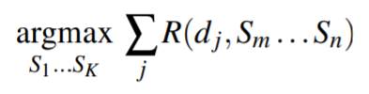
Recipe Handling (Reward Function)
For each sentence, d, infer a sequence that maximizes reward function, R:
Reward function is a probability distribution parametrized with log-linear model
Trained using recipes annotated with correct action - positive examples
Forms negative examples by finding trajectories resulting in wrong final state
Maximize likelihood of training set on model parameters with gradient descent
Notes:
Every state sk has following collection of states:
Sik unused ingredients
Sbk mixing bowl and contents
Ssk cookie sheet and contents
Sok oven and contents

Slide 18
Plan Assembly and Execution
Take predicted state/action sequence and convert to baking primitives
Each baking primitive is a single cooking action with motion primitives
No supported baking primitive → ask user for help
To execute, approximate current world state and plan moves to ensure the completion of the baking primitive (forward/inverse kinematics)
Robot detects ingredients using map
Each action has its own challenges

Slide 19
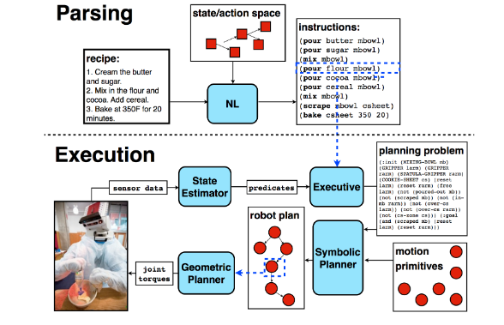

Slide 20
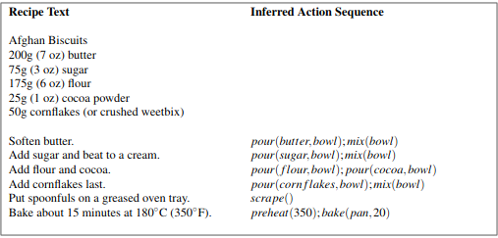
Experiments
Collected 60 recipes from the internet
Ingredients are loaded in
Annotated the sequence of the actions the robot should take for each instruction
Trained on 45 tested on 15
Ingredients pre-measured and distributed
16/27 times this recipe ran to completion
Avg time of 142 minutes!
Mixing: 27 mins
Putting item in oven: 18 mins

Slide 21
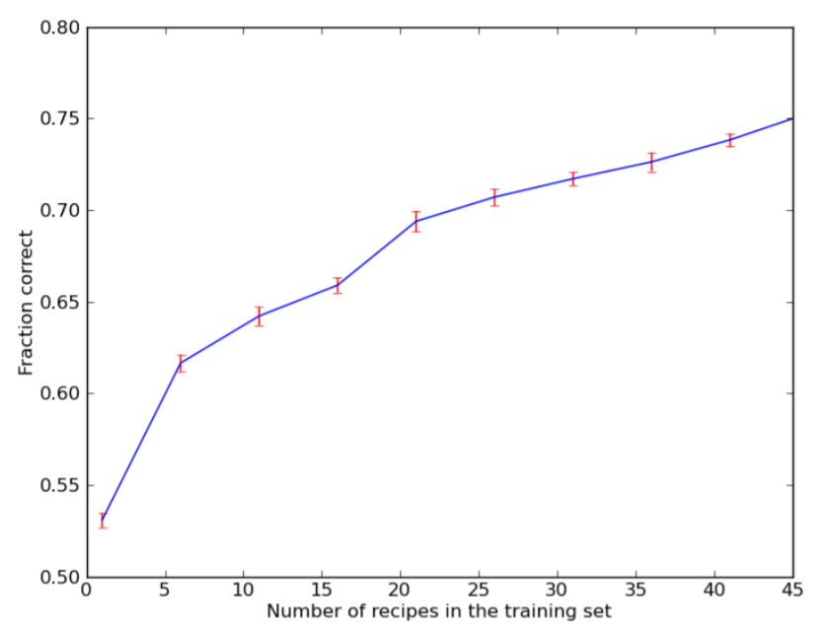
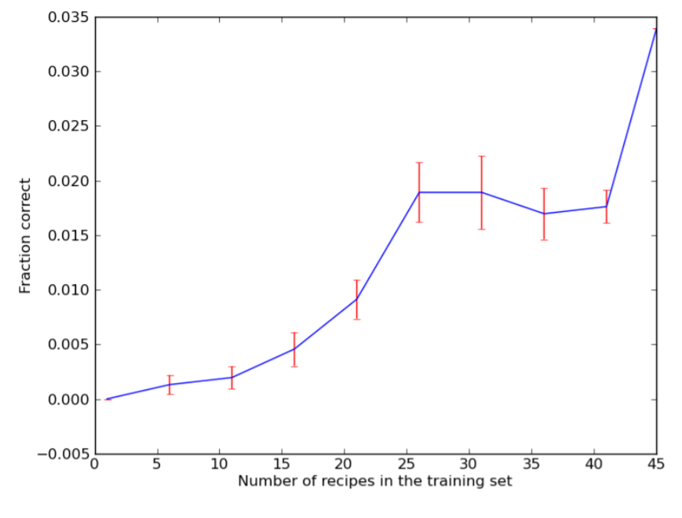
Results
15 test set recipes with 92 sentences
Only 4/15 test recipe’s action sequences right - difficult because if you miss one ingredient it could ruin the whole process

Slide 22
Challenges/Future Work
Absurdly long time to complete a recipe
Lacks certain cooking abilities
Use more sensors (thermal) to get better estimate of when something is cooked and how well
Argue that one day a robot chef can be on the same level as humans

Slide 23
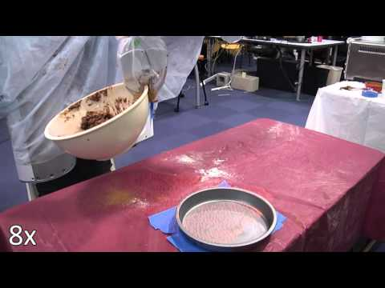

Slide 24
Learning to Interpret Natural Language Commands through Human-Robot Dialog
Authors: Jesse Thomason et al.
IJCAI 2015

Slide 25
Overview
Important for robots to understand instructions from naive users
Many instruction approaches either use:
keyword search (too simple)
large hand-annotated training corpora with robot action-language pairs (expensive and heavily reliant on training data)
This paper discusses a robot which uses dialog to learn semantic meaning from conversation
Uses semantic parser to translate user speech to logical form representation
Maintains belief state of user’s goal
Agent induces dialog to help clarify user’s goal
When confident about user’s goal, uses previous dialogue to form new training examples

Slide 26
Dialog Agent
Semantic Parser maps natural language of user using lambda calculus and combinatory categorical grammar (CCG) with UW SPF
Knowledge Base with basic facts of the environment (like people, rooms, items)
Agent maintains a belief state about user’s goal is represented with the components of action, patient, recipient
Each component is a histogram of confidences
Action can either be walk or bring items so represented by two confidence values [0,1]
Recipient/patient are values in knowledge base or null
All confidences initialized to 0 when a conversation begins

Slide 27
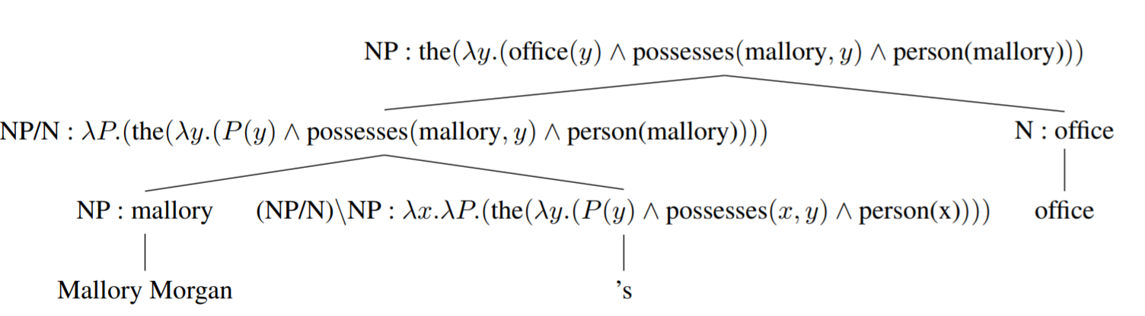
Semantic Parsing & Knowledge Base Grounding
Query knowledge base → verify that y=3508 satisfies expression because that office belongs to Mallory
Multiple satisfying objects → decrease agent’s confidence
Train up-front with only 5 utterance/logical form pairs
Seed lexicon of only 105 entries

Slide 28
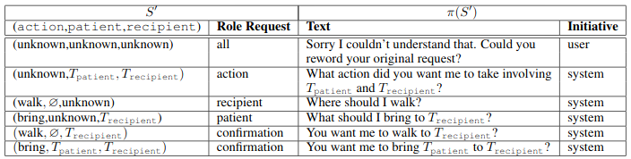
Belief State and Responses
If there is ambiguity in a user’s utterance, the agent’s confidence in the ambiguous component decreases
For example, “go to the office” → high confidence in action (walk), but there are many offices
Agent has a continuous belief state S, which gets discretized to 3-tuple with either unknown or the top candidates within each component
Agent asks either confirmation, component, or all request depending on S’

Slide 29
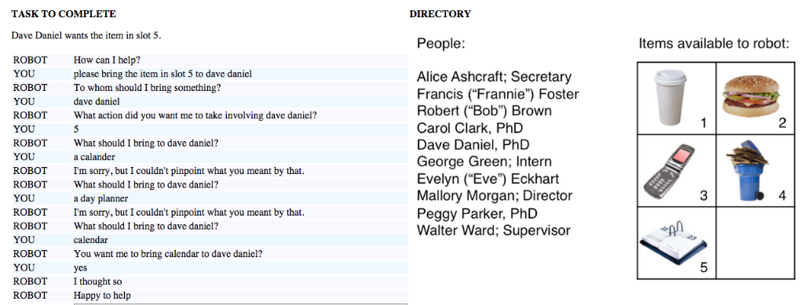
Conversational Learning
Another example is “please report to room” → walk action, report similar to go
Notes:
Didnt know planner, 5, or misspelling of calender
Confident in action of bring
Clarified dave daniel as recipient
What should i bring dave daniel - no denial so increase confidence
Retrain with all of the synonyms just learned…

Slide 30
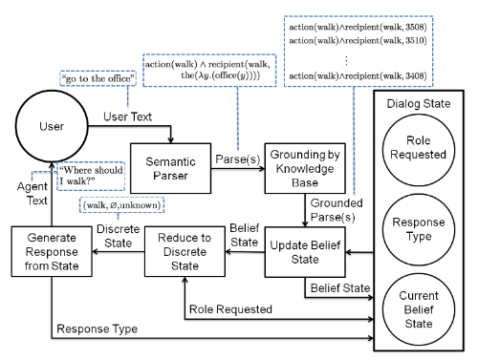
Workflow

Slide 31
Mechanical Turk
Navigation - send a robot to a room
10 rooms
“[person] needs the robot. Send it to the office [s]he works’
Person either chosen as first name, full name, nickname, or title
Delivery - deliver item to a person
10 people, 5 different items → 50 goals for each
“[person] wants the item in slot [number]”
80/20 train/test splits
Incrementally learn over 3 batches

Slide 32
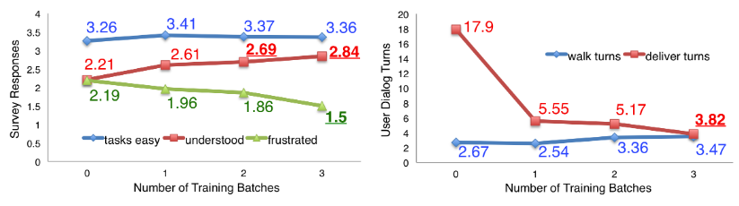
Mechanical Turk Results

Slide 33
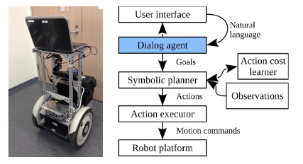
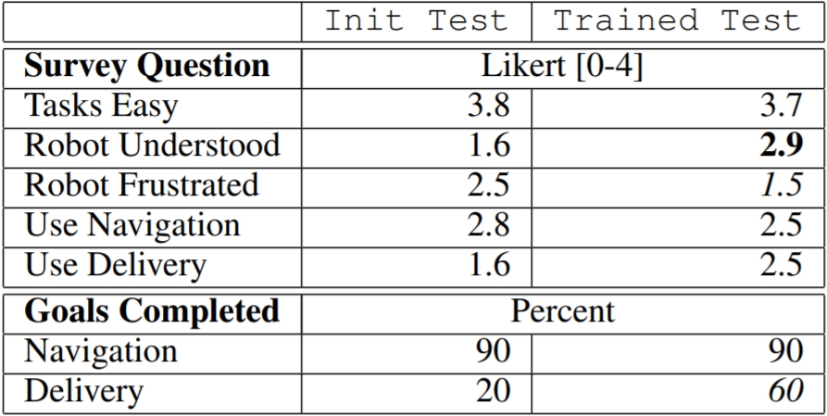
Segbot Experiments
Users interact with robot through typing natural language into GUI
Robot also has access to sensors like lasers for knowing when doors are open, and sonar and cameras for avoiding obstacles
Incrementally learned for 4 days

Slide 34
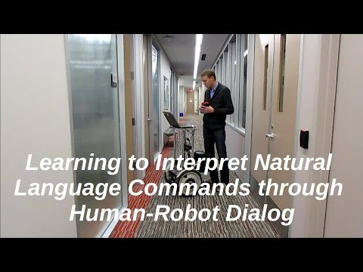

Slide 35
Improving Grounded Natural Language Understanding through Human-Robot Dialog
Authors: Jesse Thomason et al.
ICRA 2019

Slide 36
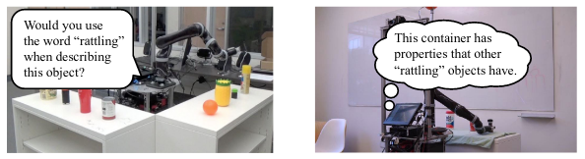
Overview
Enhance strategy by adding perceptual concepts (visual, audio, haptic) to aid in learning
Similar outline to previous project. First, test agent’s learning capabilities and usability on MTurk and then move over to physical system
Three tasks this time: navigation, delivery, and relocation
Update belief state to have Action, patient, recipient, source, goal
Notes:
Navigation - go to location
Delivery - take object to person
Relocation - take object from source to goal

Slide 37
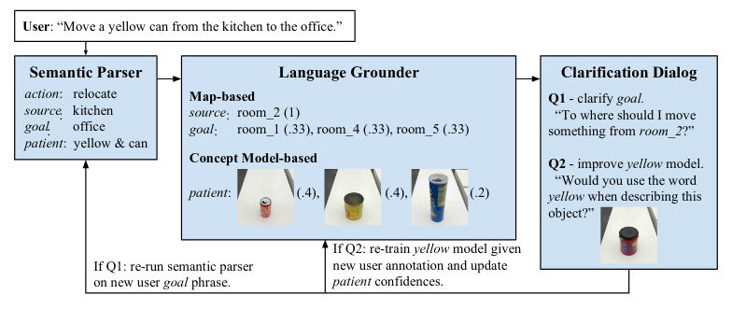
End-to-end pipeline

Slide 38
Semantic Parser
Takes in utterance, converts to semantically meaningful representation in a logical form
Similar to previous paper
Additional word embeddings used at test time to recover from words that the robot does not know
Use known word “take” to know a similar meaning to unseen word “grab” at inference time

Slide 39
Language Grounding
“The same semantic meaning can ground differently depending on the environment”
“The office by the kitchen” or “the room next to us”, etc.
Multi-modality! -GPS
Before experiments, the robot builds multi-modal feature representations of objects by:
Performing grasp, lift, lower, press, drop, push, look on all objects
Record audio with a microphone
Record haptic info with force sensors in its arm
Record vision with RGB camera
Behavior-modality spaces for audio, haptic, visual (look-vision, drop-audio)
Map feature representation by learning weights for behavior-modality spaces for a given word

Slide 40
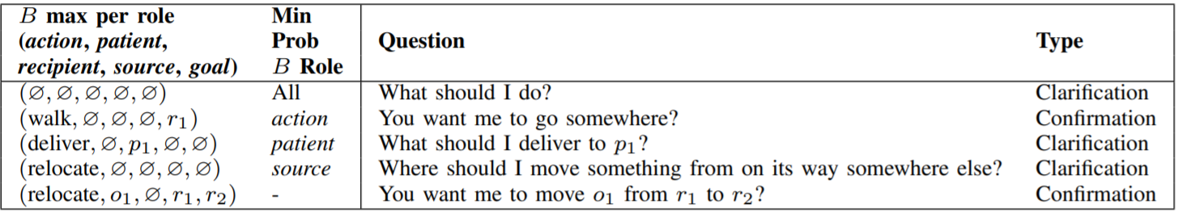
Clarification Dialog
Belief state models user’s true task
Infers with user’s language + perception of world, get confidence values for all of belief state roles.
Highest probability used to ask question. Confirmation sets the belief role at 1.

Slide 41
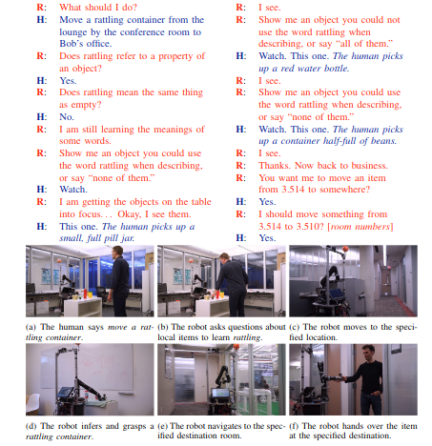
Learning from Conversation
Opportunistic Active Learning:
If the robot does not know a word, and it has semantic form involving perception, looks to confirm synonyms by asking the user about the new word’s similarities to its nearest neighbors (e.g., tall and long)
Semantic Parser Learning
Identify utterance-denotation pairs through confirmation (“robert’s office → goal)
Agent finds latent parse for the pair
Create a beam of parses for utterance and use as additional, weakly-supervised training

Slide 42
Experiments
32 objects - 24 for training, 8 for testing
Split tasks into (room, person, object) into initialization (10%), train (70%), and test (20%) sets
Initialization
16 users gave two natural language commands (initial and rephrased) to build initial lexicon and utterance-semantic parse pairs (annotated by hand)
No labels between objects and words
Training
Three phases → retrain parser and perceptual models each time

Slide 43
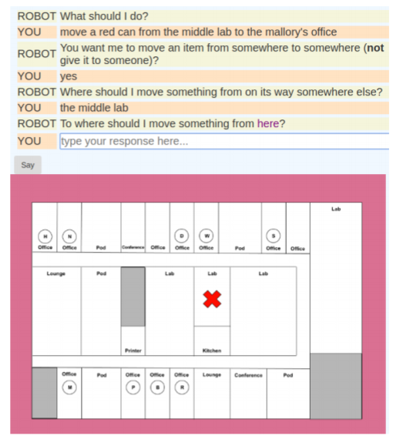

Slide 44
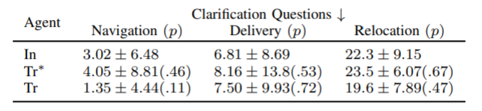
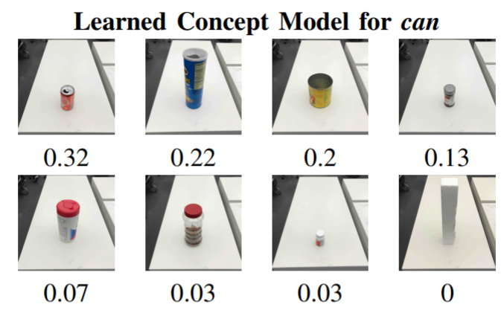
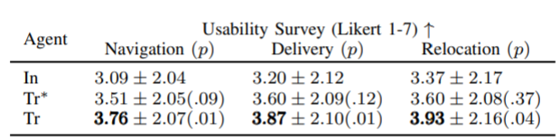
Results

Slide 45
Continued Obstacles
Need human to be truthful throughout the dialog
More than just the semantic roles of patient and source in real world situations
Limited actions defined
Graded adjectives - light suitcase is heavier than a heavy mug

Slide 46
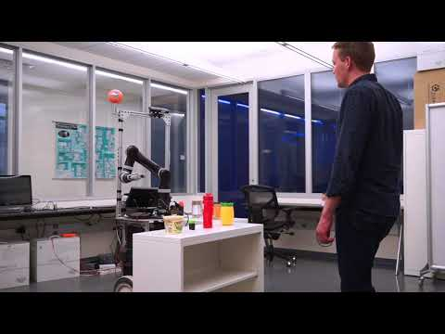

Slide 47
Grounded Language Learning: Where Robotics and NLP Meet
Author: Cynthia Matuszek
IJCAI 2018

Slide 48
Overview
Language learning as a grounded problem has the benefits of:
Robots can use context of their environments to assist in their understanding
Makes robots seem more “human-centric”, social agents
Robots can learn through interactions with human users
Robots can acquire “first-hand” semantic representations of language about objects/tasks
This paper focuses on statistical ML to learn mappings between words and their real-world representation using language/sensory input for training

Slide 49
Open Challenges
Human Robot Dialog for Active Learning
Robot asks questions of human to direct its own learning (saw in earlier paper)
Incorporate some social aspects to robot like dialogue
Especially important in local/customized learning specific to environment (“my mug”)
Shared Learned Models among Agents
Robots in similar environments can learn from each other
Beyond Objects and Tasks
Way more to learn than just color, shape, type
Abstract meaning needs to incorporate models of time, people, intent

Slide 50
Discussion

Slide 51
Discussion Question #1
What applications of NLP do you see in Robotics, beyond the examples that I mentioned today?

Slide 52
Discussion Question #2
What is most important application of NLP in Robotics, in your eyes? The social part between a robot and a human or something else?

Slide 53
Discussion Question #3
BakeBot was one example of an in-home robot that utilizes NLP.
What other applications can you think of?

Slide 54
Discussion Question #4
Do you see any ways that we can improve some of the NLP strategies that I mentioned both with human dialogue and with recipe handling?

